Slide 1
Pilot CloudHub Naming Strategy
Raghu
v1.2

Slide 2
Goals: Naming convention
Design Centre
API Manager
Mule project application naming
API URIs
CloudHub runtime manager

Slide 3
Design Centre: API Specification
API Type | Pattern | Examples
System | {System name being exposed} {?Domain} {?Subdomain} API | Workday API, Workday Employees API, Workday Employees Positions API
Process | {Domain} {?Subdomain} {?Verb indicating the process being defined} API | Employees API, Employees Hiring API, Employees Expenses API
Experience | {?Consumer Name AND/OR Context} {?Domain} {?Subdomain} API | Mobile/Web Employees API (This API deals with multiple domains but one consumer called Mobile/Web) Employees API (This API is for multiple consumers but deals with one domain called Employees) Mobile Customers API (This customers API is for mobile consumer) Mobile/Web Employees Expenses API (This API deals with multiple domains but one consumer called Mobile/Web) Kiosk Employees API (This employees API is for kiosk consumer)

Slide 4
Design Centre: Fragment Naming
Category | Pattern | Examples
Data Type | {Domain} Data Type | Account Data Type, Identity Data Type
Security Scheme | {Layer} Security Scheme, where {Layer} could be Sys, Prc, Exp | Sys Security Scheme, Prc Security Scheme
Trait | {Name} Trait | Pageable Trait
Resource Type | {Name} Resource Type | Get Resource Type
Library | {Name} Library | Payments Library
User Documentation | {Name} Documentation | Naming Conventions Documentation
Example | {Method} {Name} {Request|Response} Example | Get Accounts Response Example
Annotation Type | {Name} Annotation Type | Custom Annotation Type

Slide 5
API Manager
Asset Type | Pattern | Examples
REST API RAML: System | {System name being exposed} {?Domain} {?Subdomain} API | Workday API, Workday Employees API, Workday Employees Positions API
REST API RAML: Process | {Domain} {?Subdomain} {?Verb indicating the process being defined} API | Employees API, Employees Hiring API, Employees Expenses API
REST API RAML: Experience | {?Consumer Name} {?Domain} {?Subdomain} API | Mobile/Web Employees API (This API deals with multiple domains but one consumer called Mobile/Web) Employees API (This API is for multiple consumers but deals with one domain called Employees) Mobile Customers API (This customers API is for mobile consumer) Mobile/Web Employees Expenses API (This API deals with multiple domains but one consumer called Mobile/Web) Kiosk Employees API (This employees API is for kiosk consumer)
SOAP API WSDL | {Domain} {?Process} WSDL | Employees Expense Reimbursements WSDL
HTTP API | {Domain} {?Process} {?Name of the api being proxied} Proxy | Products Pricing Proxy

Slide 6
Mule project application naming
How best to name a Mule project?
All lower case
Hyphen-separated
Maximum length - 30 characters [where first 4 characters are reserved (sys-/prc-/exp-/int-/prx-), and only 26 characters available for a meaningful name]
Assumes that each major project version has its own repository
API Type | Pattern | Mule Project Examples
System | sys-{System name being exposed}-{?Domain}-{?Subdomain} | sys-workday sys-workday-employees
Process | prc-{Domain}-{?Subdomain}-{?Verb indicating the process being defined} | prc-employees prc-employees-hiring
Experience | exp-{?Consumer Name}-{?Domain}-{?Subdomain} | exp-kioskdata exp-kiosk-finance exp-employees (For more than one consumers)
Integration | int-{Domain}-{?Process}-{?Source}-{?Target} | int-expenses-extract int-sap-prodb
Proxy | prx-{Domain}-{?Process}-{?Name of the api being proxied} | prx-products-pricing

Slide 7
API URIs
How best to structure an API URI?
The structure of a URI is central to how APIs are organized and categorized within your enterprise domain
A good URI taxonomy helps to categorize your APIs across functional domains, regions, and relationships (hierarchical) between them
A good URI also helps to govern the lifecycle of your API through versioning practices

Slide 8
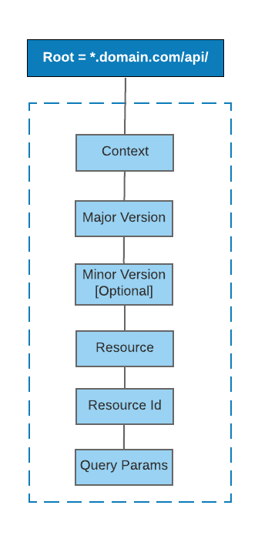
API URIs
https://${domain}/api/${context}/${major-version}/${optional-minor-version}/${resource}/${resource-id}?${queryParams}
https://eu-nprd.company.com/api/dv-exp-cybergrant-data/1/entries [maps to version 1]
https://eu-nprd.company.com/api/dv-exp-cybergrant-data/1/2/entries/123?sort=+timeCreated [maps to version 1.2]
https://eu-nprd.company.com/api/dv-exp-cybergrant-data/2/entries [maps to version 2]
*Assuming DLB in place

Slide 9
API URI parts
https://${domain}/api/${context}/${major-version}/${optional-minor-version}/${resource}/${resource-id}?${queryParams}
Part | Description | Naming Standards | Example
${domain} | The domain of the enterprise | Lower case | eu-nprd.company.com
${context} | The name of the API. This typically represent a business or utility service and should be a short but descriptive name | Lower case, hyphen-separated, non prod environment prefixed | dv-exp-kiosk-data ts-exp-kiosk-data
${major-version} | The major version of the API | - | 1, 2, 3, 4, 5 …
${?optional-minor-version} | The optional minor version of the API | - | 0, 1, 2, 3, 4, 5 …
${resources} | The name of the resource that represents the actual object. An API may contain one or more resources. The resource can also be referred to as the API endpoint | Lower case, hyphen-separated for multi word resources | entries, security-groups
$resource-id} | The id of the resource to be fetched/updated. The resource id is optional and it is not applicable when we do a POST | Mostly integer, but could be alphanumeric for some user cases | 12345
${queryParams} | Query parameters/strings are often used to carry identifying information in the form of "key=value" pairs | camelCase | page=1&sort=+timeCreated, lastName, contactInfo
*Assuming DLB in place

Slide 10
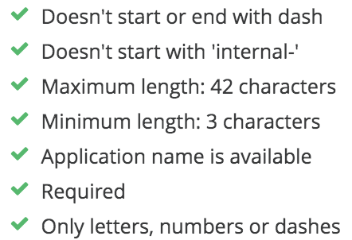
CloudHub Runtime Manager naming strategy
How best to name a CloudHub application?
All lower case
Unique
{org}{access}-{region}{env}-{33-characters-mule-project-naming}-v{major-version}
Part | Description | Naming Standards | Examples
org | Abbreviation for Company | cp | cp-eudv-exp-kiosk-data-v1
access | Optional character used only for naming external APIs that could be accessed by consumers outside company network | x | cpx-eudv-exp-kiosk-data-v1
{region} | Deployment region | eu – Europe us - US | cp-eudv-exp-kiosk-data-v1 cp-usdv-exp-kiosk-data-v1
{env} | Non prod environments only | dv – Development ts – Testing pp – Pre-prod | cp-eudv-exp-kiosk-data-v1 cp-euts-exp-kiosk-data-v1 cp-eupp-exp-kiosk-data-v1
{mule-project-naming} | Name of the mule project as per the mule project naming strategy | As per the mule project naming strategy | cp-eudv-exp-kiosk-data-v1
{major-version} | Major API version | 1, 2 … | cp-eudv-exp-kiosk-data-v1

Slide 11
REST RAML API E2E Naming convention example
Design & Publish
Manage
Build
Deploy
Consume
Part | Design Center & Exchange Asset Name | API Manager Name | Mule Application Project Name [33 characters max] | CloudHub Runtime Manager Application Name | Endpoint URL
Description | Name of the asset on design centre which in turn is used to publish the asset on Exchange | Name imported from Exchange while creating API Manager instance | Name of the mule project | Name of the application on CloudHub | Final endpoint URL to invoke and consume the API
Example | Employees API [1.0, 1.1, 2.0] | Employees API [1.0, 1.1, 2.0] | exp-employees [Each major version should be a new mule project. Major version can have multiple minor versions with multiple API kit routers] | cp{x}-eudv-exp-employees-v1 [x is for public facing APIs and should be ignored for private APIs, For major version change replace v1 to v2] | https://eu-nprd.company.com/api/dv-exp-employees/1/employees [where 1 is major version]

Slide 12
DLB URL mapping
Public DLB settings
Whitelisted CIDRs: 0.0.0.0/0
Add new rule mapping for public APIs. Include ‘x’ to public facing APIs runtime manager name
Input path: /api/{app}/{major-version}/
Target app: cpx-{eu/us}{app}-v{major-version}
Output path: /api/
Optional https upstream
E.g. : eu-nprd.company.com/api/dv-exp-employees/1/employees → cpx-eudv-employees-v1/api/employees [in this case the app name in runtime manager is cpx-eudv-employees-v1 for dev environment in EU region, and cp-euts-employees-v1 for test environment in US region]
VPC Firewall settings
Only allow 8091/8092 from VPC CIDRs
App settings
HTTP listener on 8091/8092
HTTP requester in Mule flows should use internal-<lb-name>.lb.anypointdns.net to invoke other APIs

